Slide 1
Midway Design Review
Smart Hub
Team 23
December 10, 2015
Notes:
‹#›
‹#›
‹#›

Slide 2







Patrick Lowry
EE ‘16
Team Manager
Chris Mitchell
EE ‘16
Sidney Saycocie
EE ‘16
Aman Sardana
EE ‘16

Slide 3
Overview
Smart Hub bridges the gap of modern home appliance complexity
  It automates temperature and lighting devices to suit a homeowner’s needs
Jasper, its built-in, voice-activated system is always listening for commands
  Operation of devices becomes faster and easier
Web-server functionality for remote control of appliances

Slide 4
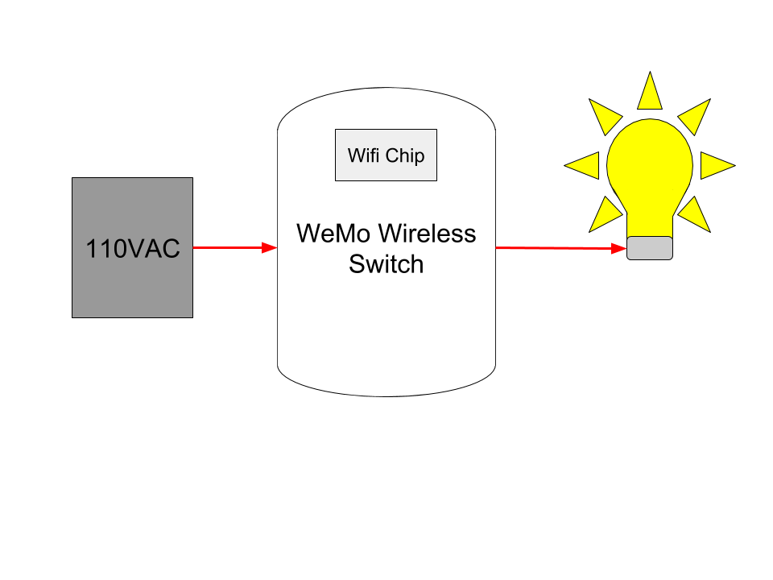
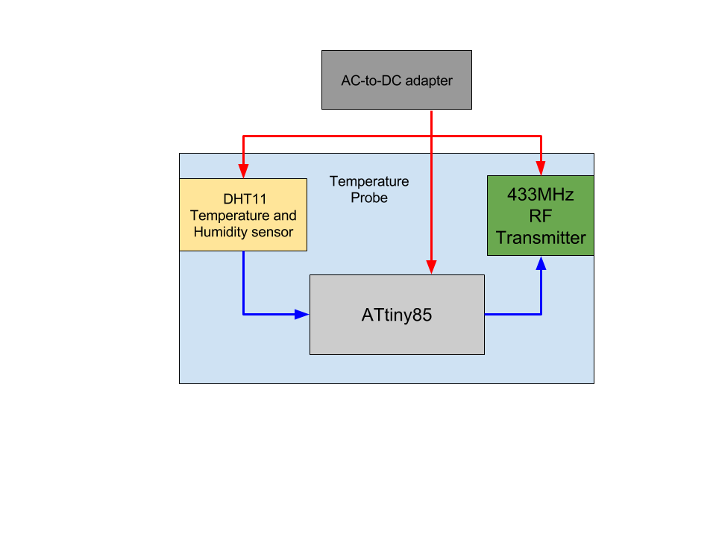
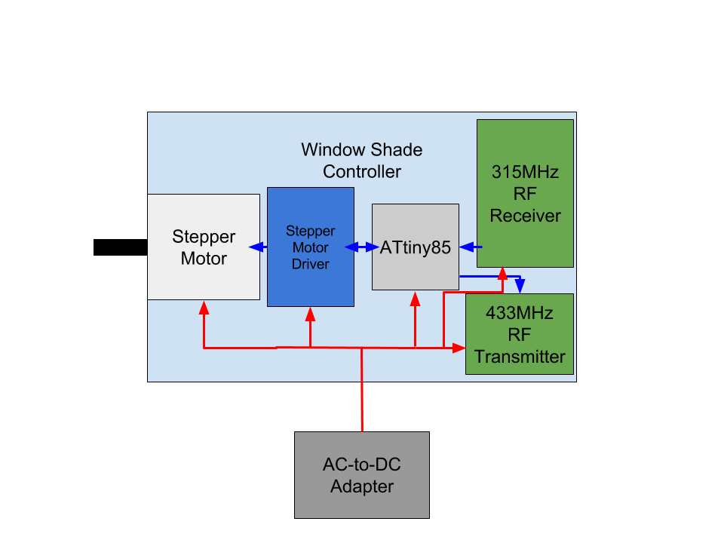
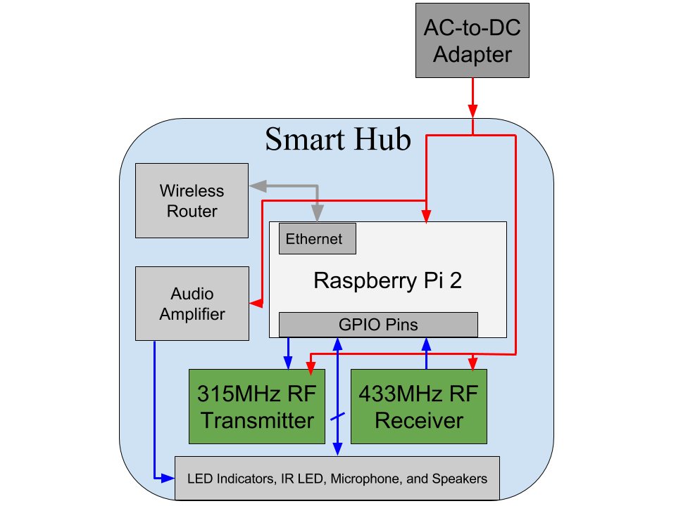
Block Diagram
Legend
Power
Information
Ethernet
WiFi
315MHz
433MHz
IR
Window AC Unit

Slide 5
Proposed MDR Deliverables
A fully assembled, enclosed hub capable of:
Interacting with a Wemo light bulb
    Performing and responding to basic voice commands using Jasper
  Reporting indoor temperature from probe
  Able to remotely manage window shade controller

Slide 6
Deliverables
Mostly assembled hub, now with built-in wireless router
Apache web server running on RP2, with html/css formatted php website
Working temperature and humidity probe reporting values to connected Arduino Uno
Automatic window shade circuit diagram and code

Slide 7
Requirements (Temp. Probe)
Basic Operation and Design
- Monitors indoor temperature and humidity for AC control
- Must use a microcontroller and a temperature/humidity sensor
Report Time
- User determined (via web server or Jasper)
- Or, 1 sample recorded and sent per minute (automatic setting)
Communication
- 433MHz RF transmitting antenna
- Send temperature and humidity (16-bit)

Slide 8
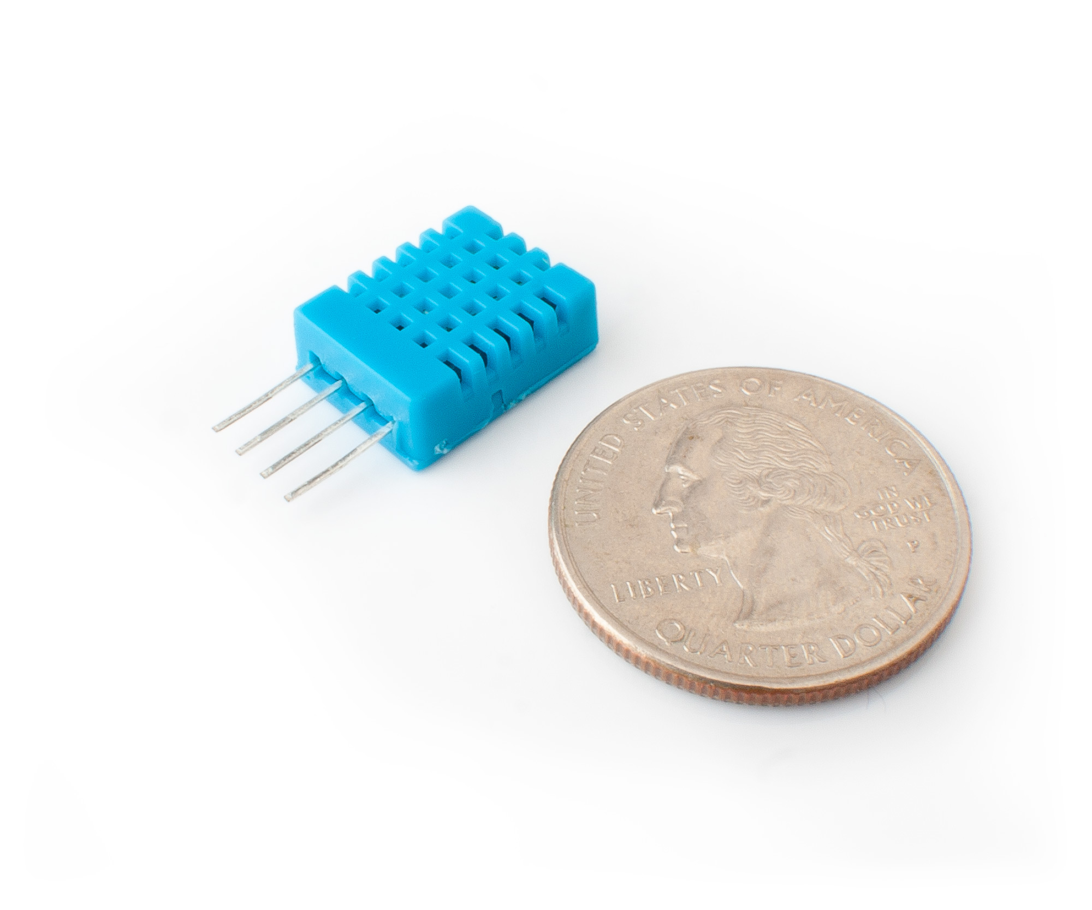
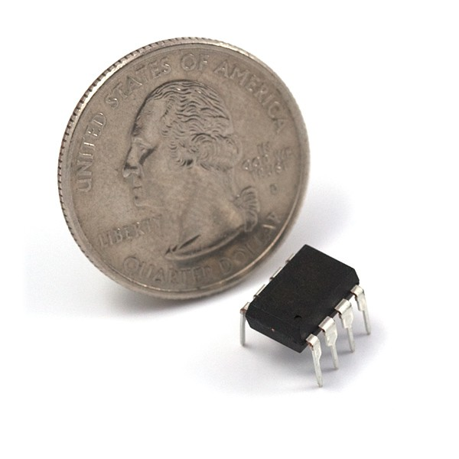
Temperature Probe
Sensor: DHT11
<$2
Good for 20-80% humidity readings with 5% accuracy
Good for 0-50°C temperature readings ±2°C accuracy
Samples data every 2 seconds
Microcontroller: ATtiny85
<$2
Arduino IDE

Slide 9
Block Diagram (MDR)
5V
Temperature Probe
DHT11 Temperature and Humidity sensor
Legend
Power
Information
ATtiny85

Slide 10
Block Diagram (CDR)
Legend
Power
Information

Slide 11
Requirements (Blinds)
Communication
- 315MHz RF Receiving and 433MHz Transmitting Antennas
Basic Operation and Design
- Open and close commands (8-bit RF signal)
- <10 seconds from time of command to open/close
- Must use ATtiny85 microcontroller (8KB)
- Must use Arduino IDE and Manchester code for RF
- Must operate at 15VDC and 2A for motor and driver, 5V for ATtiny85 and RF
- Motor must have enough torque for roller blinds (~60oz.in)

Slide 12
Window Shade Controller
Motor Driver:EasyDriver
<$10
6-30V and min. 2A (actual results may vary)
~100ms period for rising edge step signal
Microcontroller: ATtiny85
<$2
Arduino IDE
Motor:RioRand Stepper Motor
<$30
125oz.in(200steps/rev)

Slide 13
Block Diagram(MDR)
Window Shade Controller
Stepper Motor
Stepper Motor Driver
ATtiny85
Legend
Power
Information
Power
Supply

Slide 14
Schematic(MDR)
Stepper
Motor
Driver
ATtiny85
Red
Green
Black
Blue
A
B
5V(out)
Step
Dir
GND
M+
8-Vcc
7-step
6-dir
5-in
4-GND
Stepper
Motor
Control
Input
+ -
Power
Supply

Slide 15
Code
int dirpin = 6;
int steppin = 7;
void setup() {
pinMode(dirpin, OUTPUT);
pinMode(steppin, OUTPUT);
}
void loop()
{
int i;
digitalWrite(dirpin, LOW); // Set the direction.
delay(100);
for (i = 0; i<4000; i++) // Iterate for 4000 microsteps.
{
digitalWrite(steppin, LOW); // This LOW to HIGH change is what //creates the rising edge
digitalWrite(steppin, HIGH);
delayMicroseconds(100); // Delay so motor doesn’t stall
}
digitalWrite(dirpin, HIGH); // Change direction.
delay(400);
for (i = 0; i<4000; i++) // Iterate for 4000 microsteps
{
digitalWrite(steppin, LOW); // This LOW to HIGH change is what
//creates the rising edge
digitalWrite(steppin, HIGH);
delayMicroseconds(100); //Delay so the motor doesn’t stall
}
}

Slide 16
Block Diagram
Legend
Power
Information

Slide 17
Requirements (Hub)
Wireless Communication
- Internet: Wifi (using wireless router and ethernet)
- Must be able to control a retail smart device (Belkin WeMo)
- RF Peripheral Control: 315MHz and 433MHz
- Must be able to control AC window unit with IR
- Minimum range of RF: 20m (including through cinderblock)
Voice Control
- Jasper (open source voice control platform)
- Built-In Microphone and Speakers
- Confidence of Jasper (when to ask for confirmation)

Slide 18

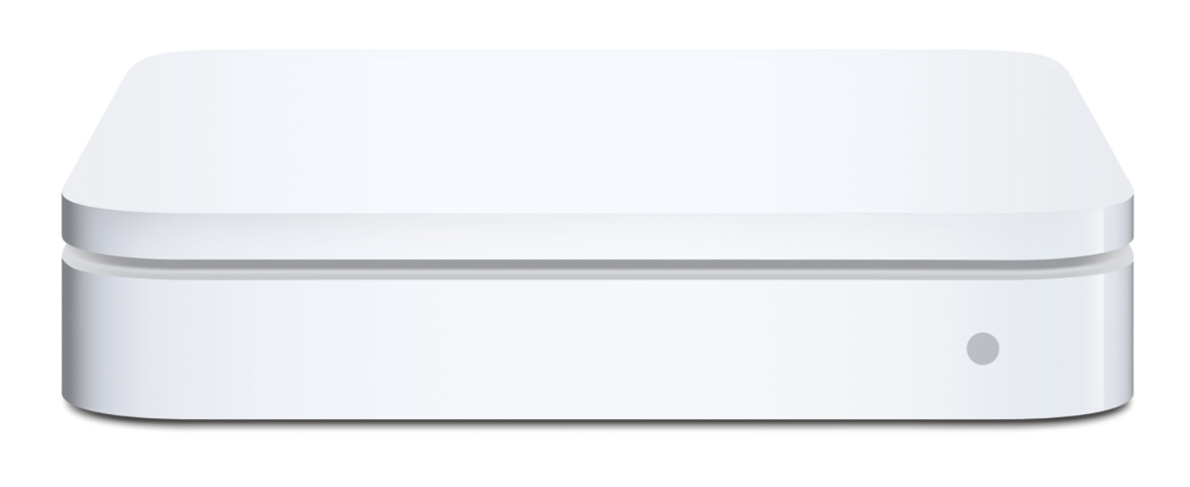
Requirements (Hub cont.)
Basic Operation and Design
- Controlled by Raspberry Pi 2
- Operates at 12VDC (RP2 can supply 5V and 3.3V)
- Uses Raspbian OS with autorun Python scripts
- Provides web server for remote control of devices
- Sleek, unobtrusive design

Slide 19
Smart Hub
Controlled by Raspberry Pi 2
12V 6A supply
Netgear N150 wireless router (integrated)
2.0 audio amplifier and speakers (integrated)
Room for RF chips and an exhaust fan
Reasonable size and unobtrusive design

Slide 20
Updated Block Diagram
Legend
Power
Information
Ethernet

Slide 21
Smart Hub Cost Analysis
Main System
Wireless router (Netgear WNR1000-100NAS N150 $21.99 (retail)
Raspberry Pi 2 Model B $38.61 (retail)
2.0 Speaker system $14.99 (retail)
RioRand LM2596 DC-DC Buck Converter 2 x $1.88 (retail)
12V 5 or 6A AC/DC adapter ~$9-10 (retail)
3D-Printed case (168g ABS) $5
USB Microphone $10-30 (retail)

Slide 22
Smart Hub Cost Analysis Cont.
Cooling System
Slim 5V fan ~$5 (retail)
DS18B20 temperature sensor $0.96 (retail)
PN2222A transistor $0.48 (retail)
Peripheral Communication
Wifi (included with wireless router)
433MHz RF transmitter and receiver 2 x $0.99
315MHz RF transmitter and receiver $0.99
38kHz IR receiver $0.45 (retail)
450nm IR transmitter 2 x $0.48
Miscellaneous (wires, ethernet cable, resistors, aluminum, nuts and bolts) ~$5

Slide 23
Smart Hub Cost Analysis Cont.
Total (retail):
$118.18 - 139.18
Considerably less expensive when parts are purchased at cost and assembled in high quantities

Slide 24
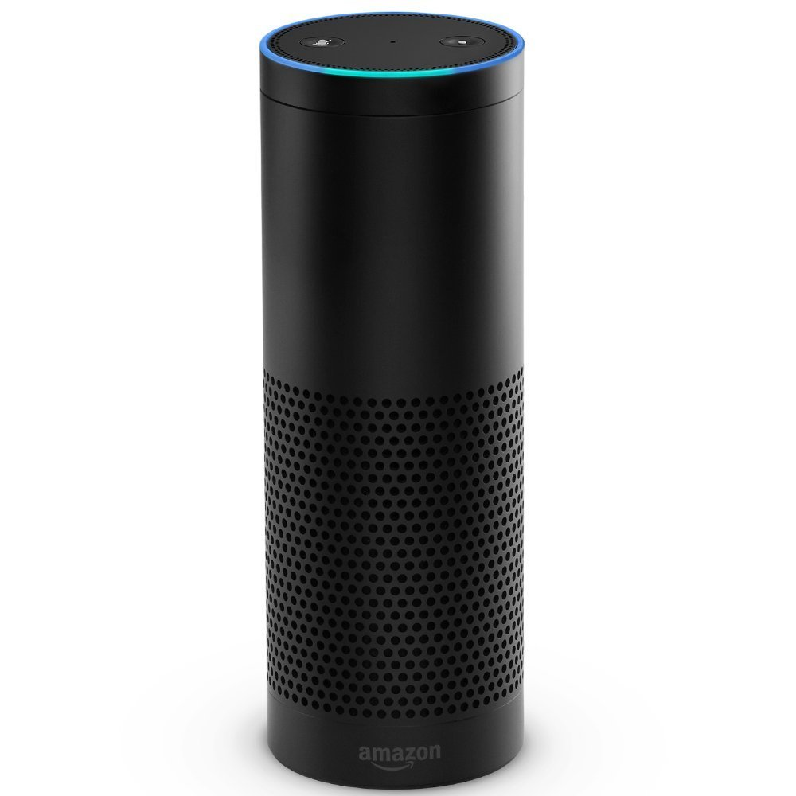
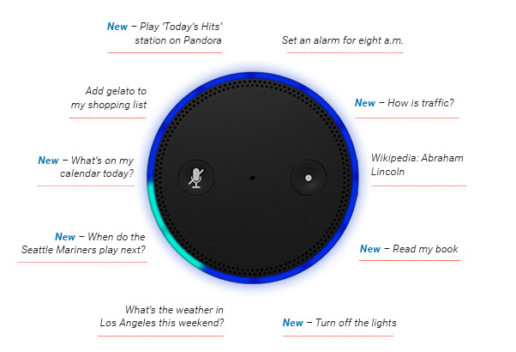
Smart Hub Alternative
Amazon Echo with Alexa AI $179.99

Slide 25
Smart Hub Alternative Cont.
Pros
Attractive design
Excellent audio for size
Recently added support for controlling Belkin WeMo, Philips Hue, and more
Simple voice control and response (Alexa software clearly enunciates responses)
Hears you from across the room with far-field voice recognition, even while music is playing

Slide 26
Smart Hub Alternative Cont.
Cons
Expensive
Needs separate wireless router
Limited remote access (only for music, alarms, shopping lists, etc)
Can’t control non-wifi devices or wifi devices that aren’t supported by Alexa phone app
No options for external audio

Slide 27
Comparison of Systems
 | Smart Hub | Amazon Echo | Belkin WeMo | Philips Hue
Companion App | ✓ | ✓ | ✓ | ✓
Internet Connectivity (Wifi) w/ Remote Access | ✓ | Only Certain Services Through Alexa App | ✓ | ✓
Light Control | ✓ | ✓ | ✓ | ✓
Outlet Control | ✓ | ✓ | ✓
Voice Control w/ Integrated Audio | ✓ | ✓
Connected App Capabilities (Social Media, Weather, News) | ✓ | ✓
RF Control | ✓
IR Control | ✓
Wireless Router | Integrated | Separate | Separate | Separate
Price | $118.18 - 139.18 (plus peripherals) | $179.99 (plus peripherals) | >$39.99 - 169.98 | >$199.99

Slide 28
Smart Hub Connect
A web server that lets a registered Smart Hub user control his/her home appliances remotely
  A login is required to provide security against unauthorized personnel
Apache-based, delivers HTML pages and php scripts
  Serves as the hub’s online presence
    Will contain tutorials on the operation of the hub
    Individual control options for each appliance

Slide 29
A companion to Jasper
Smart Hub
Command Hierarchy
Python Scripts (autorun w/ crontab)
Web Server
Jasper
Apache
Automatic Settings
Raspbian OS

Slide 30
What Connect comprises of now
An Apache web server running on our Raspberry Pi
An upcoming website that is served up by apache with a GUI that will soon be able to control home appliances

Slide 31
Proposed CDR Deliverables
Refer to provided Gantt chart

Slide 32

Questions

